Slide 1
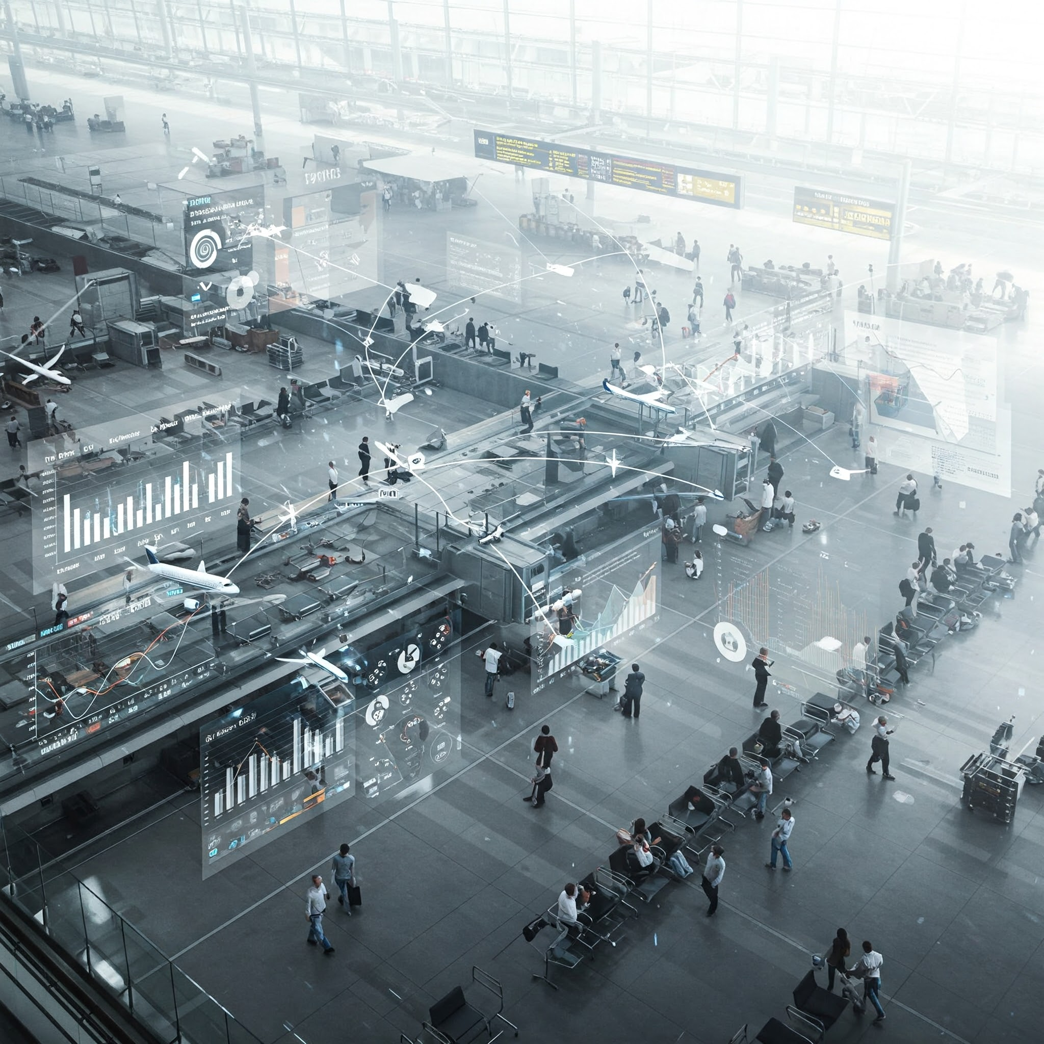
FLIGHT DATA ANALYSIS
GAURAV KHANOLKAR
MAYUR PATIL

Slide 2
INTRODUCTION
Objective of the Analysis:
To analyze airline performance by examining various metrics including flight delays, distances, and operational efficiency.
Overview of Flight Data Analysis
Importance of analyzing flight data for improving efficiency, safety, and customer experience.
Techniques Used in Python
Data preprocessing and visualization.

Slide 3
INSIGHTS
Time Period Covered:
Flight data from January 2015 - December 2015
Key Variables:
Flight delays
distances
airline performance
airports

Slide 4
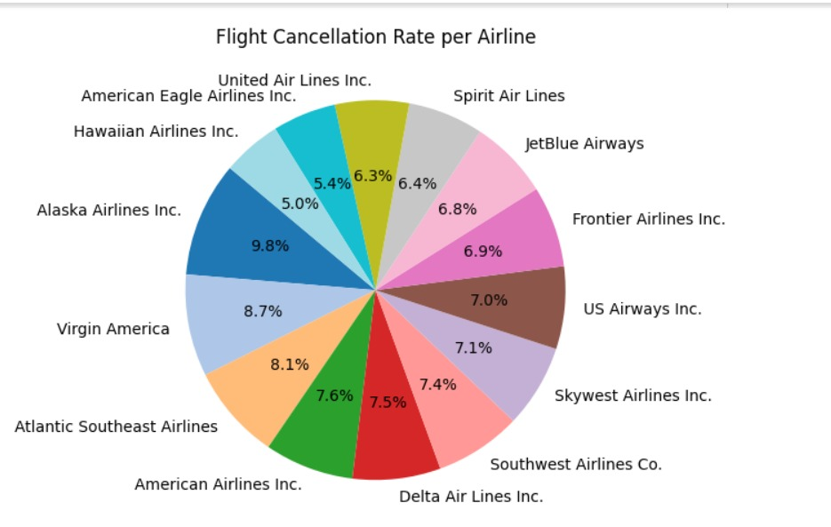
The pie chart clearly shows the proportion of cancellations for each airline, making it easy to compare at a glance.
Different airlines have different rates of flight cancellations.
Alaska Air Lines Inc. Highest: Unfortunately, Spirit has the highest cancellation rate at 9.8%.
American Eagle Airlines Close Behind: With a 5.4% cancellation rate, they perform well too.
Hawaiian Airlines Shines: They have the lowest cancellation rate at just 5.0%.
Other Airlines in the Middle: Most other airlines fall somewhere between these extremes, ranging from around 6% to 8%.

Slide 5
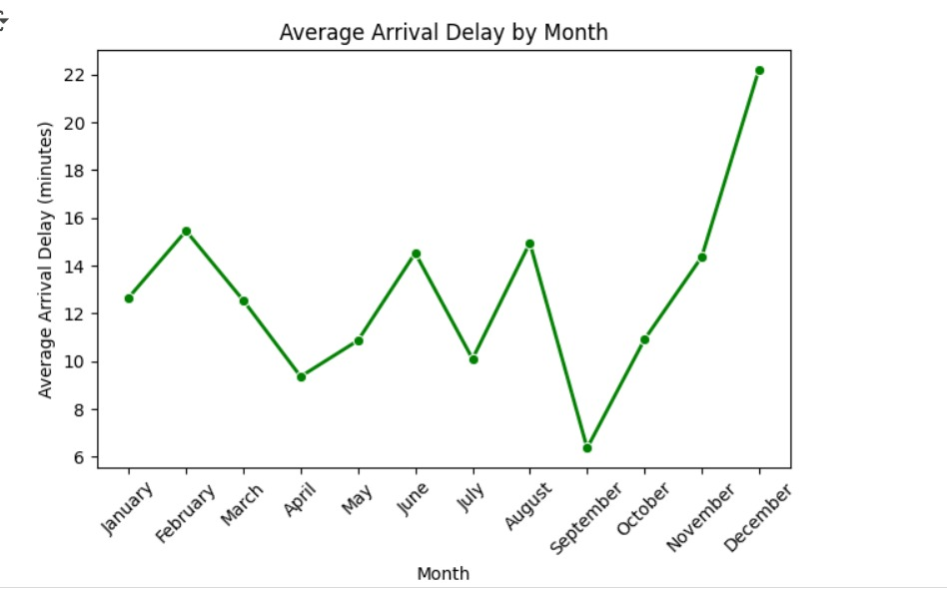
The average arrival delay isn't constant throughout the year; it goes up and down.
Summer Spike: Delays tend to increase in the summer months (June, July, August), peaking in August.
Holiday Rush: There's a significant jump in delays in December, likely due to holiday travel.
September Sweet Spot: September seems to have the lowest average arrival delays.
Spring Dip: Delays are generally lower in the spring months (March, April).
Overall Trend: While there are dips, there's a general upward trend in delays towards the end of the year.

Slide 6
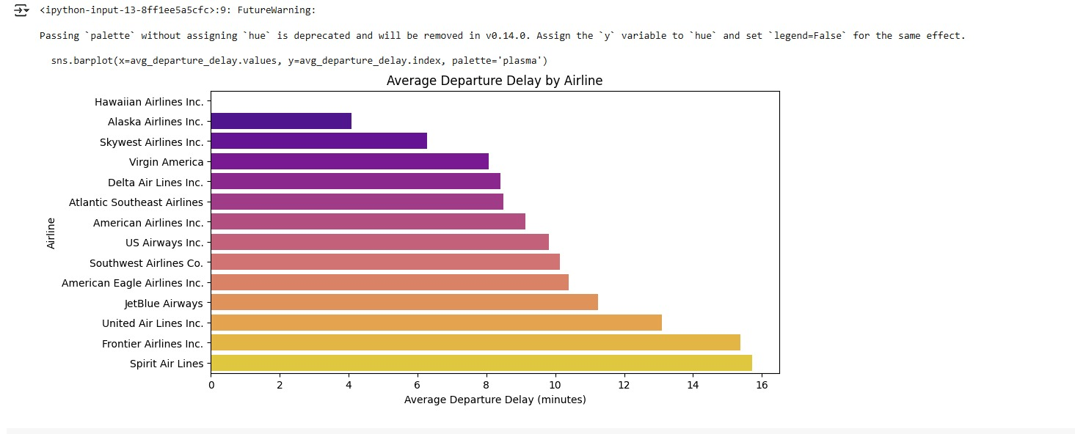
The color gradient in the bar chart visually highlights the spectrum of departure delays, from shortest to longest.
Hawaiian Airlines Leads the Way: They boast the shortest average departure delay, close to zero minutes!
Alaska and Skywest Also Good: These airlines also show relatively low average departure delays.
Spirit Air Lines Has Highest Delays: On the other end of the spectrum, Spirit Air Lines has the longest average departure delays.
Frontier and United Also Face Longer Delays: These airlines also tend to have higher average departure delay times.
Mid-Range Airlines: Many popular airlines fall in the middle, with average departure delays ranging between roughly 7 to 11 minutes.

Slide 7
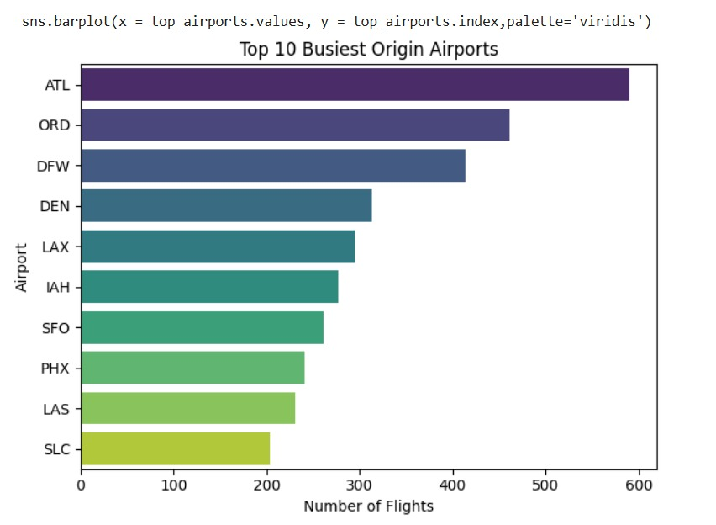
The bar chart makes it easy to see the relative order and scale of flight departures from these major airports.
The bars are colored using a "viridis" palette, transitioning from a dark purple for the busiest airport (ATL) to a lighter yellow-green for the tenth busiest (SLC).
This visualization clearly indicates the significant lead Atlanta has in terms of the number of originating flights compared to other major US airports.

Slide 8
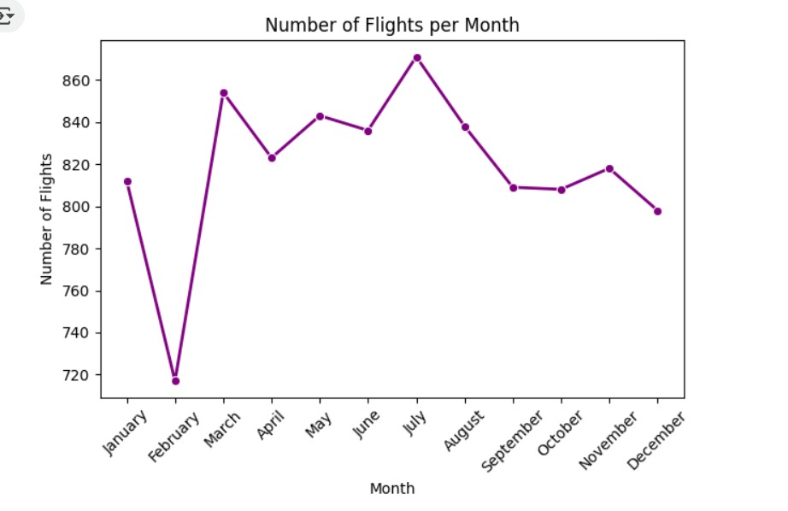
The graph shows a seasonal pattern with fewer flights in February and December, a significant increase in the spring, and a peak in the summer, particularly in July. The autumn months show a more consistent, moderately high number of flights.

Slide 9
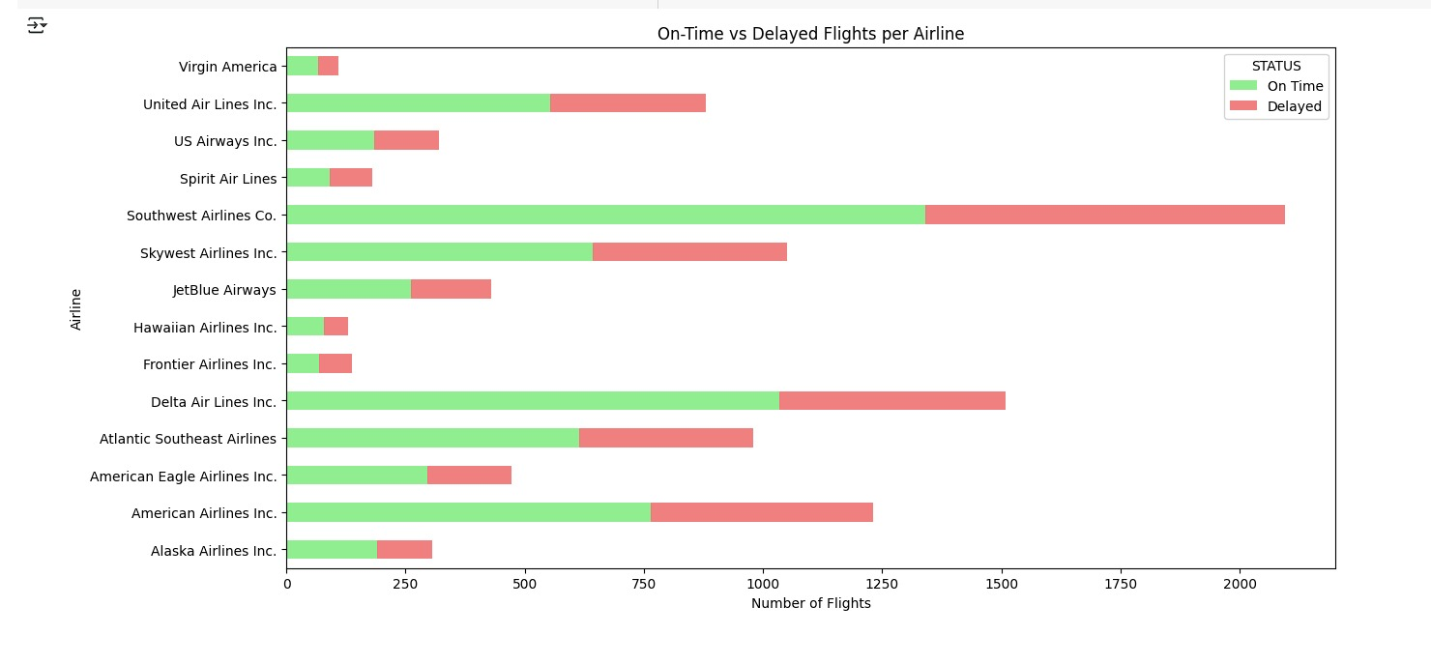
The chart allows for a direct comparison of the number of on-time versus delayed flights for various airlines, highlighting the reliability performance of each.
Southwest Airlines Co. appears to have the highest total number of flights represented, while Hawaiian Airlines Inc. and Virgin America show a very high proportion of on-time flights.
Spirit Air Lines and Frontier Airlines Inc., on the other hand, indicate a higher proportion of delayed flights relative to their on-time flights.

Slide 10
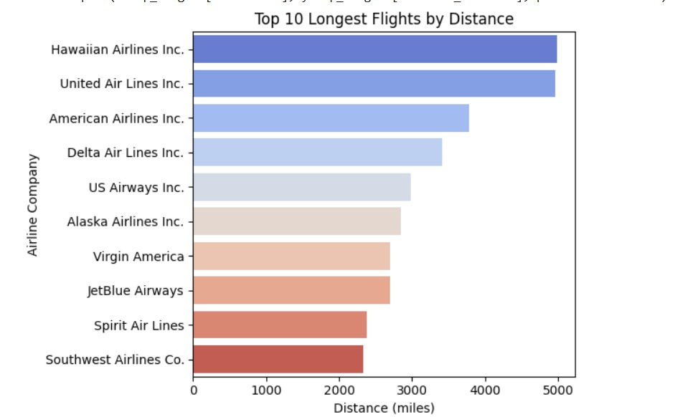
The bars are colored using a gradient, transitioning from blue for the longest flights to red for the shortest among the top 10.
The chart clearly shows that Hawaiian Airlines Inc. and United Air Lines Inc. operate the longest flights by distance among these airlines.

Slide 11
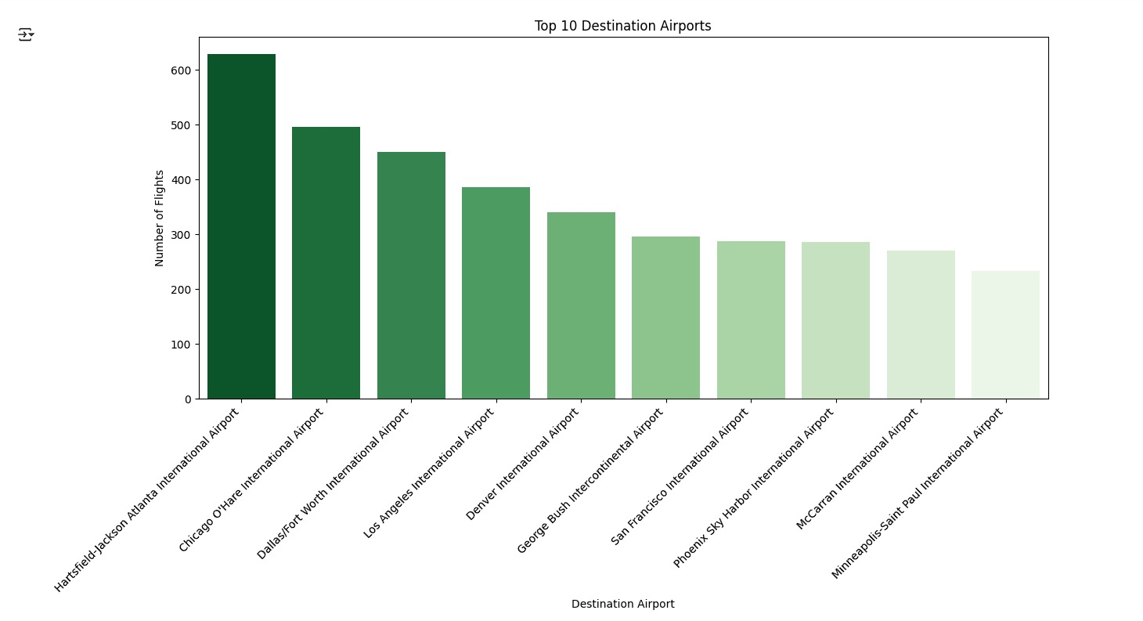
The bars are colored using a gradient of green, with darker shades representing airports with a higher number of arriving flights and lighter shades indicating fewer arriving flights among the top 10.
The chart clearly indicates that Hartsfield-Jackson Atlanta International Airport is the most popular destination among these top 10, receiving a significantly higher number of flights compared to the others.

Slide 12
CONCLUSION
The data reveals a complex landscape in the airline industry, shaped by airline-specific operations, seasonal patterns, and hub airport dynamics.
By understanding these trends, we can make better travel decisions and gain a deeper appreciation of the factors influencing air transportation.

Slide 13
ANY QUESTIONS?
THANK YOU

